Slide 1

PostGIS and Spatial Queries
GIS in the Sciences
ERTH 4750 (38031)
Steve Signell, Instructor
Tuesady, April 3, 2018

Slide 2
Introduction
Database – collection of persistent data
Database Management System (DBMS) – software system that supports creation, population, and querying of a database

Slide 3
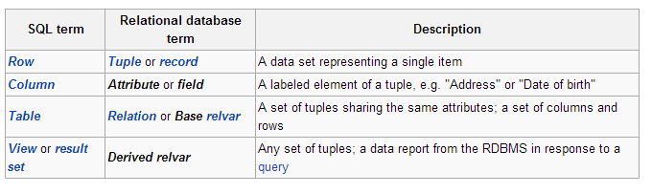
Relational Database
Relational Database Management System (RDBMS)
Consists of tables organized into schemas (folders)

Slide 4
Relational Database
Example table:
‘Students’ (sid, name, login, age, gpa)
Students identifies the table
sid, name, login, age, gpa identify attributes
sid is the ‘primary key’– a unique identifier that is associated with that row. Never changes!
Usually primary keys are just sequential integers.

Slide 5
An Example Table
Students (sid: integer, name: string, login: string, age: integer, gpa: decimal)
sid | name | login | age | gpa
50000 | Dave | dave@cs | 19 | 3.3
53666 | Jones | jones@cs | 18 | 3.4
53688 | Smith | smith@ee | 18 | 3.2
53650 | Smith | smith@math | 19 | 3.8
53831 | Madayan | madayan@music | 11 | 1.8
53832 | Guldu | guldu@music | 12 | 2.0

Slide 6
Another example table: Courses
Example table:
‘Courses’ (cid, instructor, quarter, dept)
cid is the primary key
cid | instructor | quarter | dept
Carnatic101 | Jane | Fall 06 | Music
Reggae203 | Bob | Summer 06 | Music
Topology101 | Mary | Spring 06 | Math
History105 | Alice | Fall 06 | History

Slide 7
Keys
Primary key – minimal subset of fields that is unique identifier for a object (row)
sid is primary key for Students
cid is primary key for Courses
How do we express which students take each course?
Foreign key –connections between tables
Courses (cid, instructor, quarter, dept)
Students (sid, name, login, age, gpa)

Slide 8
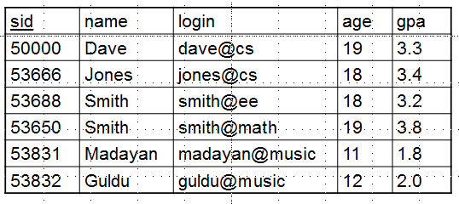
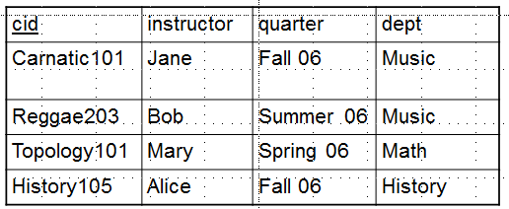
Putting it together
Enrolled (enroll_id, sid, cid, grade)
enroll_id | sid | cid | grade
1 | 5000 | Carnatic101 | 4.0
2 | 5000 | Reggae203 | 3.0
3 | 5000 | Topology101 | 3.0
4 | 53832 | History105 | 2.5
5 | 53832 | Carnatic101 | 1.5

Slide 9
Databases & SQL
The four “verbs” of SQL (Structured Query Language)
SELECT, returns rows in response to a query
INSERT, adds new rows to a table
UPDATE, alters existing rows in a table
DELETE, removes rows from a table

Slide 10
Databases & SQL
SELECT QUERIES
Required:
SELECT (field(s))
FROM (tables)
Optional:
JOIN (combines two FROM items)
WHERE (conditions)
GROUP BY (fields– used for AGGREGATE functions)
ORDER BY (field(s))
LIMIT (# rows returned)

Slide 11
Select-From-Where query
“Find the name of all students who are under 18”
SELECT name
FROM students
WHERE students.age < 18

Slide 12
Queries across multiple tables (joins)
“Print the student name and course ID where the student received an ‘A’ in the course”
SELECT students.name,
enrolled.cid
FROM students, enrolled
WHERE students.sid = enrolled.sid
AND enrolled.grade = ‘4.0’
enroll_id | sid | cid | grade
1 | 5000 | Carnatic101 | 4.0
2 | 5000 | Reggae203 | 3.0
3 | 5000 | Topology101 | 3.0
4 | 53832 | History105 | 2.5
5 | 53832 | Carnatic101 | 1.5

Slide 13
Summary: Why are RDBMS useful?
Data independence – provides abstract view of the data, without details of storage
Efficient data access – uses techniques to store and retrieve data efficiently
Reduced application development time – many important functions already supported
Centralized data administration
Data Integrity and Security
Concurrency control and recovery
Spatial databases are incredibly powerful

Slide 14
So, why don’t scientists use them?
“I tried to use databases in my project, but they were just too [slow | hard-to-use | expensive | complex] . So I use files”.
Gray and Szalay, Where Rubber Meets the Sky: Bridging the Gap Between Databases and Science
Steep(ish) learning curve
Most scientists never exposed to them in their training.
50 GIS programs surveyed, only 3 had a class in relational databases.

Slide 15
PostgreSQL
PostgreSQL, originally called Postgres, was created at UCB by a computer science professor named Michael Stonebraker, who went on to become the CTO of Informix Corporation.
Stonebraker started Postgres in 1986 as a followup project to its predecessor, Ingres, now owned by Computer Associates. The name Postgres thus plays off of its predecessor (as in "after Ingres").
Ingres, developed from 1977 to 1985, had been an exercise in creating a database system according to classic RDBMS theory.
Postgres, developed between 1986-1994, was a project meant to break new ground in database concepts such as exploration of "object relational" technologies.

Slide 16
Spatial Databases
PostGIS is a spatial extension for PostgreSQL. But what does that mean; what is it that PostGIS does that turns an ordinary database a spatial database?
The short answer, is. . .
Spatial databases store and manipulate spatial objects like any other object in the database.
The database knows where everything is so…
Find things within a certain distance of others
Find things that intersect
Find things that don’t intersect
etc.

Slide 17
Spatial Databases
Spatial data types refer to shapes such as point, line, and polygon;
data is stored in a field called ‘geom’
2. Multi-dimensional spatial indexing is used for efficient processing of spatial operations;
3. Spatial functions, posed in SQL, are for querying of spatial properties and relationships.

Slide 18

Spatial Indexing
Spatial indexing & Bounding Boxes
Answering the question “is A inside B?” is very computationally intensive for polygons but very fast in the case of rectangles.
Even the most complex polygons and linestrings can be represented by a simple bounding box.

Slide 19
Spatial Functions
https://postgis.net/docs/manual-2.1/reference.html
Conversion: Functions that convert between geometries and external data formats.
Management: Functions that manage information about spatial tables and PostGIS administration.
Retrieval: Functions that retrieve properties and measurements of a Geometry.
Comparison: Functions that compare two geometries with respect to their spatial relation.
Generation: Functions that generate new geometries from others.

Slide 20
Retrieval Functions
ST_Area: Returns the area of the surface if it is a polygon or multi-polygon. For “geometry” type area is in SRID units. For “geography” area is in square meters.
ST_Length: Returns the 2d length of the geometry if it is a linestring or multilinestring. geometry are in units of spatial reference and geography are in meters (default spheroid)
ST_NPoints: Returns the number of points (vertexes) in a geometry.
ST_Perimeter: Returns the length measurement of the boundary of an ST_Surface or ST_MultiSurface value. (Polygon, Multipolygon)
ST_X: Returns the X coordinate of the point, or NULL if not available. Input must be a point.
ST_Y: Returns the Y coordinate of the point, or NULL if not available. Input must be a point.

Slide 21
Retrieval Functions
ST_Area: Returns the area of the surface if it is a polygon or multi-polygon. For “geometry” type area is in SRID units. For “geography” area is in square meters.
ST_Length: Returns the 2d length of the geometry if it is a linestring or multilinestring. geometry are in units of spatial reference and geography are in meters (default spheroid)
ST_NPoints: Returns the number of points (vertexes) in a geometry.
ST_NumGeometries: If geometry is a GEOMETRYCOLLECTION (or MULTI*) returns the number of geometries, otherwise return NULL.
ST_Perimeter: Returns the length measurement of the boundary of an ST_Surface or ST_MultiSurface value. (Polygon, Multipolygon)
ST_StartPoint: Returns the first point of a LINESTRING geometry as a POINT.
ST_X: Returns the X coordinate of the point, or NULL if not available. Input must be a point.
ST_Y: Returns the Y coordinate of the point, or NULL if not available. Input must be a point.

Slide 22
Comparison Functions
Questions like “Which are the closet bike racks to a park?” or “Where are the intersections of subway lines and streets?” can only be answered by comparing geometries representing the bike racks, streets, and subway lines.
Other Questions:
“What neighborhood and borough is Atlantic Commons in?”
“What streets does Atlantic Commons join with?”
“Approximately how many people live on (within 50 meters of) Atlantic Commons?”

Slide 23
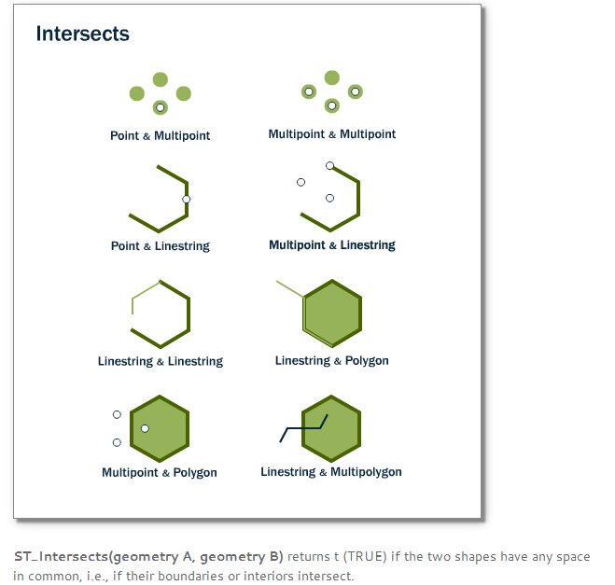
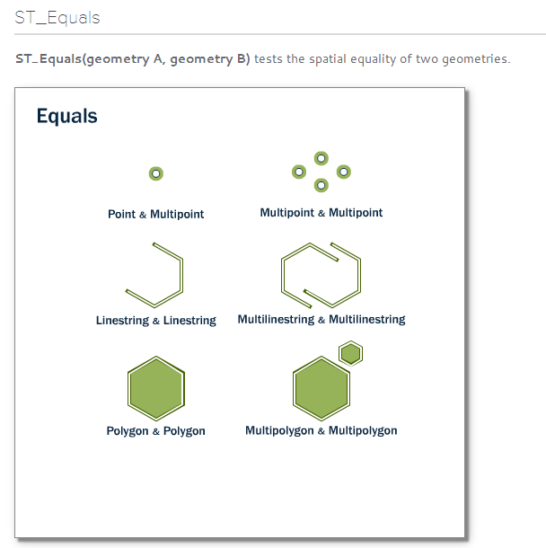
Comparison Functions

Slide 24
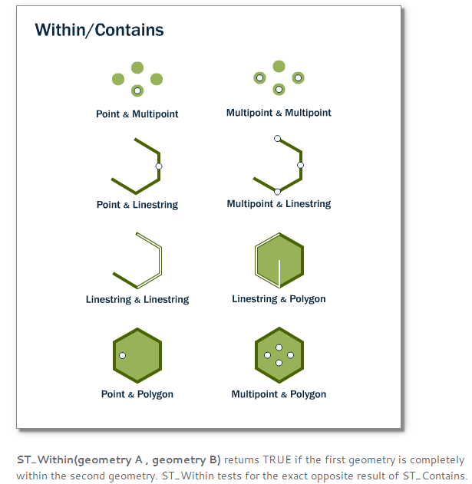
Comparison Functions

Slide 25
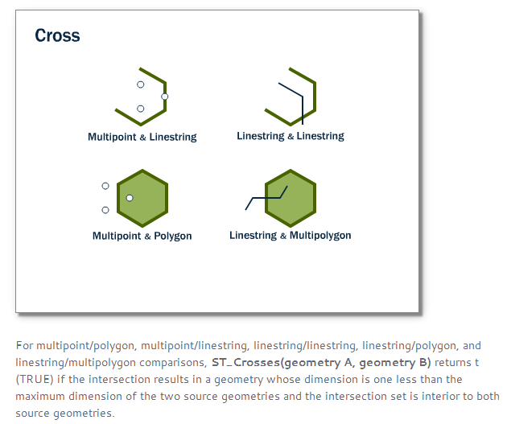
Comparison Functions

Slide 26
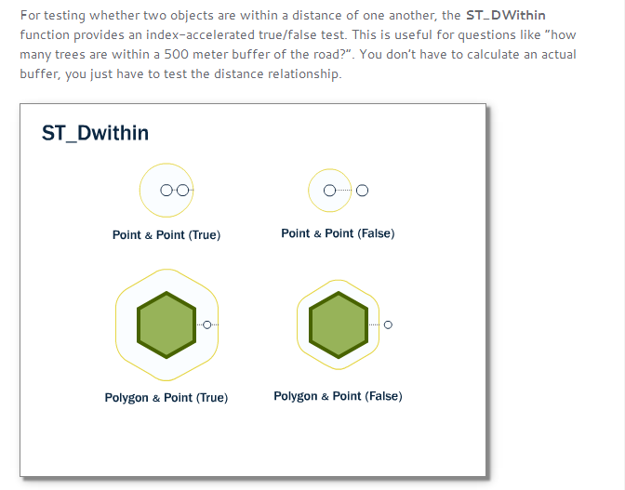
Comparison Functions

Slide 27
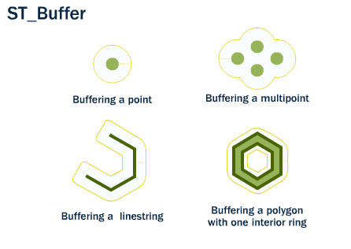
Creation Functions

Slide 28
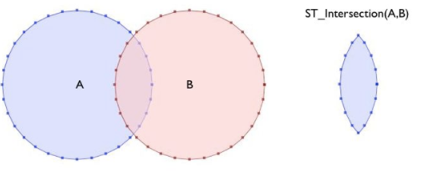
Creation Functions

Slide 29
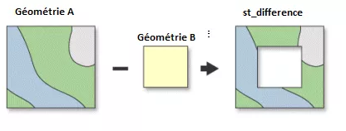
Creation Functions

Slide 30
Demos
Return all campsites:
SELECT a.uid,
a.name,
a.geom
FROM api.points a
WHERE a.keywords ilike '%campsite%’
ORDER BY a.name

Slide 31
Demos
Return all Campsites in the High Peaks Wilderness:
SELECT a.uid,
a.name,
a.geom
FROM api.points a, api.units b
WHERE ST_Intersects(a.geom,b.geom)
AND a.keywords ilike '%campsite%'
AND b.name='High Peaks Wilderness'

Slide 32
Demos
Return 200m buffers of all Campsites in the High Peaks Wilderness:
SELECT a.uid,
a.name,
ST_Buffer(
ST_Transform(a.geom,3857)
,200) AS geom
FROM api.points a, api.units b
WHERE ST_Intersects(a.geom,b.geom)
AND a.keywords ilike '%campsite%'
AND b.name='High Peaks Wilderness’
Note: geometry must be transformed (reprojected) to a CRS that has units in meters before buffering!

Slide 33
Questions?
Homework for Friday
Update your Carto Adirondack map with legends and popups if you haven’t already.
Work on getting your group data organized and start your analysis… feel free to use GitHub issues to ask me questions.

